Slide 1
Assessing road quality from space
Presented by Team Glaziers

Slide 2
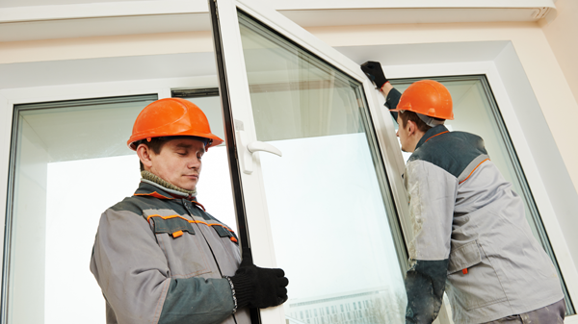
Wait, what? Team Glaziers?
Well, it’s because we fixed Windows.

Slide 3
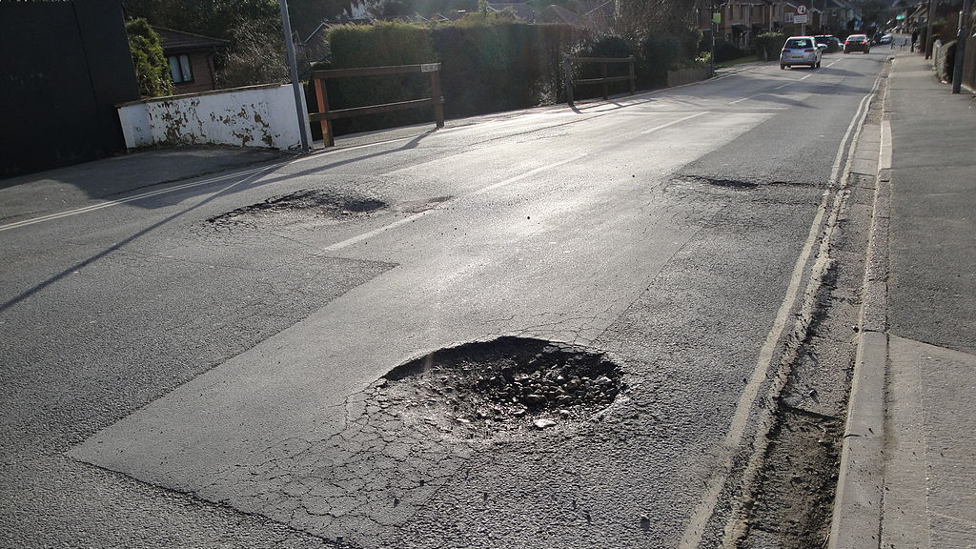
The problem
There’s a lot of roads. They all need monitored and maintained.
Let’s make it smarter.

Slide 4
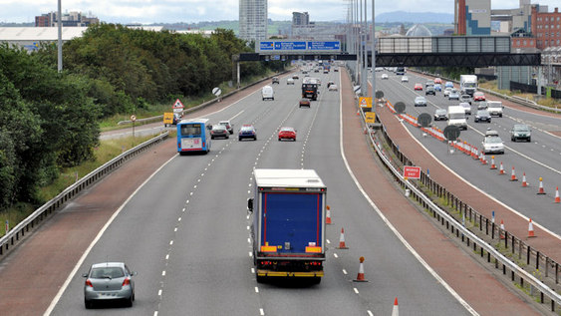
Our idea
Evaluate road quality based on features extracted from satellite imagery
Identify unreported and predict future surface defects
Confirm the presence of reported surface defects

Slide 5
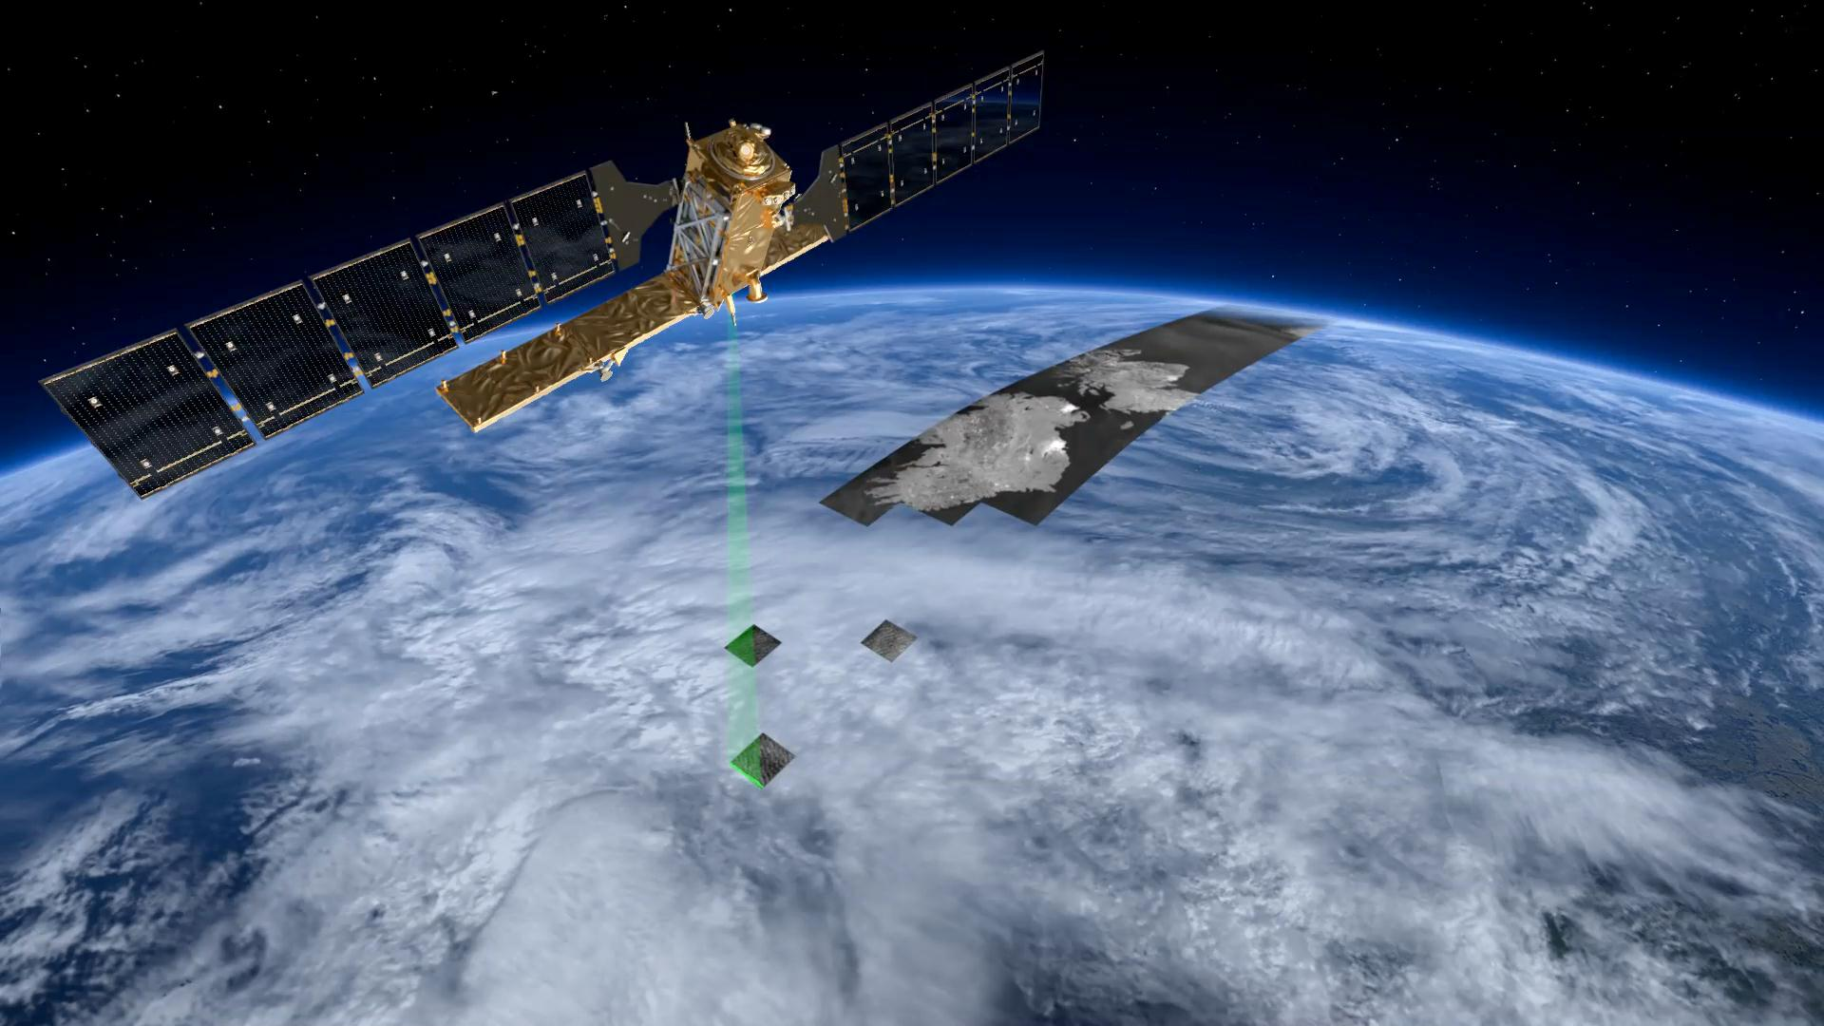





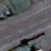




How we did it
Satellite imagery of Belfast, Derry and Enniskillen
Open source machine learning
ArcGIS

Slide 6
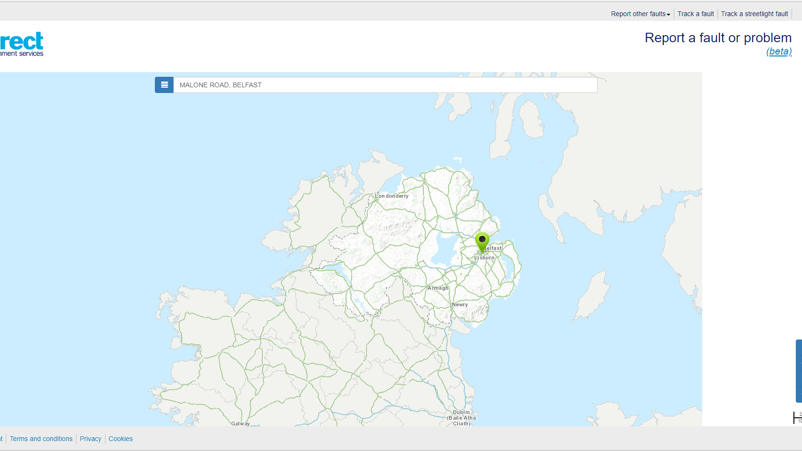
The product
Expanding upon existing infrastructure.

Slide 7
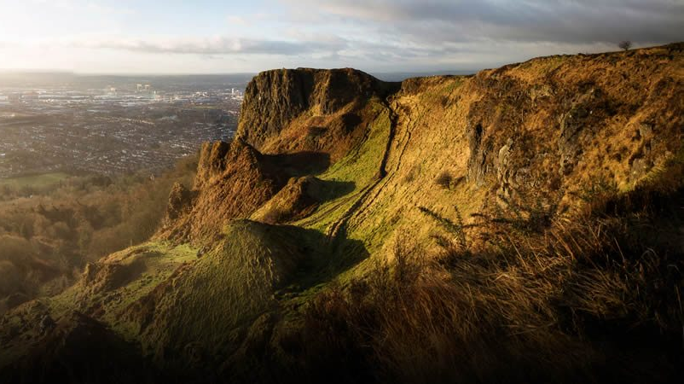
Benefits to the environment
Better roads means better fuel efficiency.

Slide 8
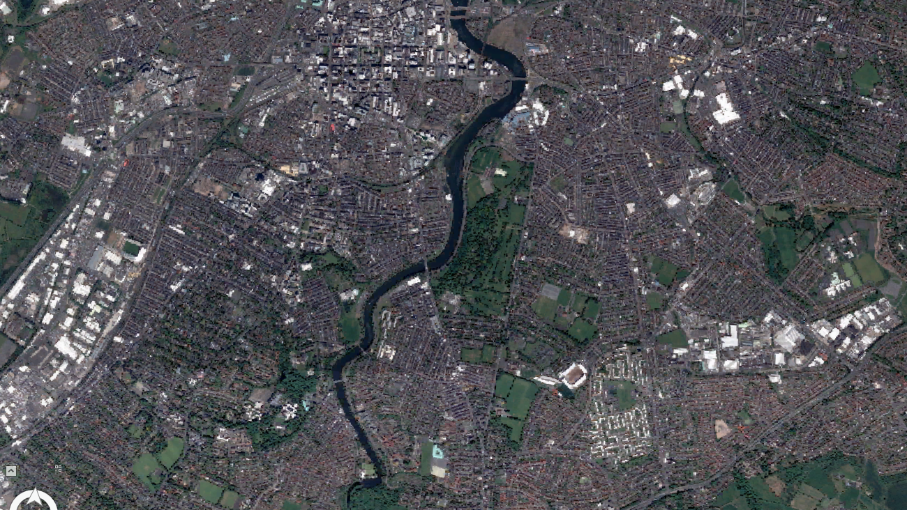
Safer roads
Safer transport for cyclists, public transport and cars on the road.

Slide 9
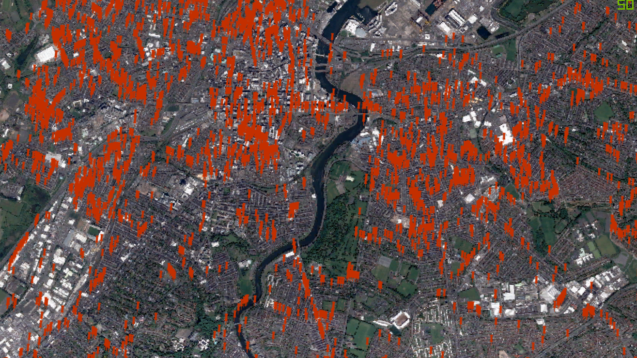

Safer roads
Safer transport for cyclists, public transport and cars on the road.

Slide 10
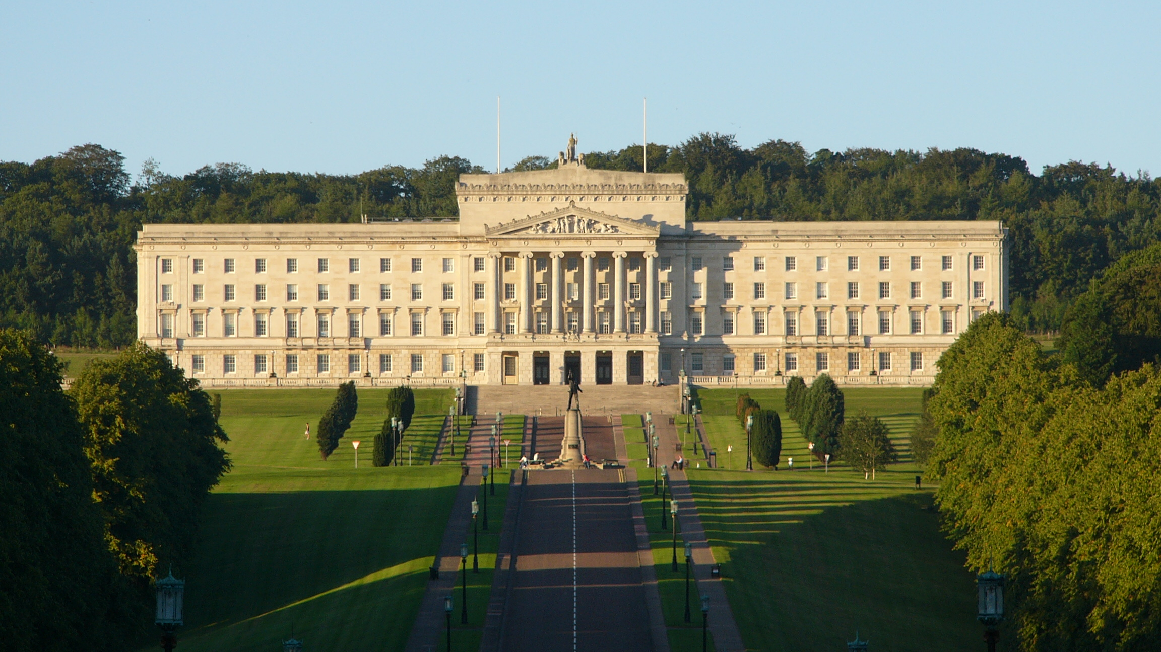
Reducing costs
£500,000 spent in compensation for damage caused by potholes across a two year period
£25,000,000 spent on repairing road surface defects

Slide 11
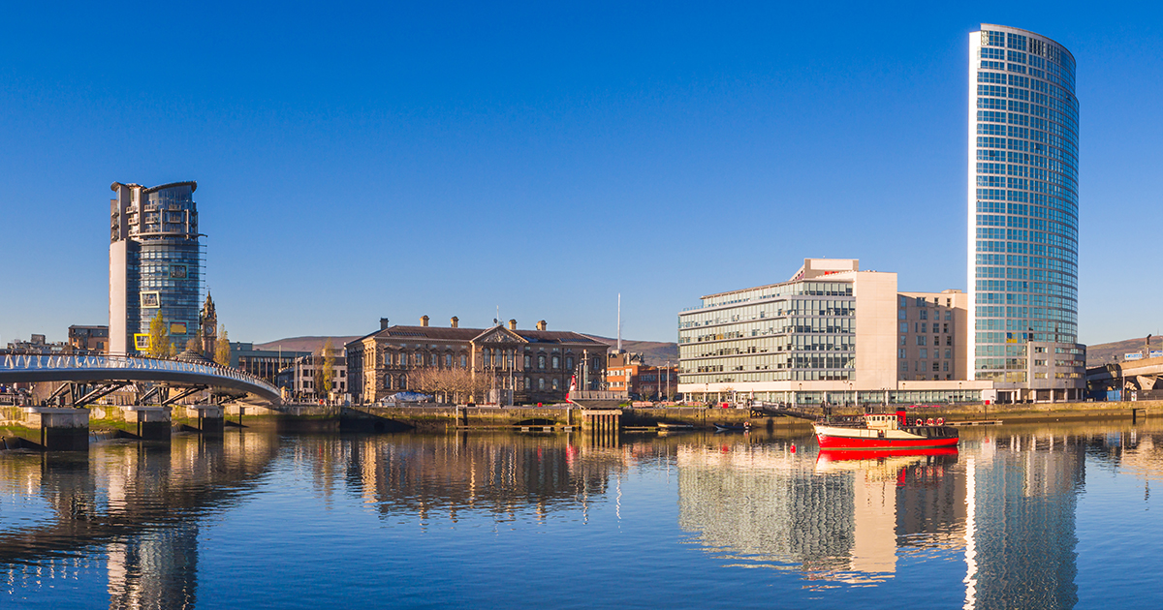
Thanks for listening
Any questions?

